Slide 1

Digital Marketing

Slide 2
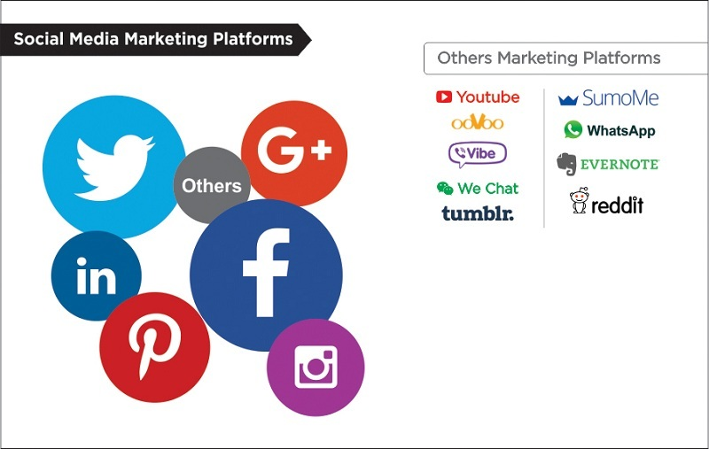
WHAT IS DIGITAL MARKETING?
Digital marketing, also called online marketing, is the promotion of brands to connect with potential customers using the internet and other forms of digital communication.

Slide 3

BENEFITS OF DIGITAL MARKETING
1. | 2. | 3. | 4. | 5.
Global Reach | Higher Revenue | Effective Targeting | Time And Effort Saving | Real Time Analysis
SUCCESS

Slide 4
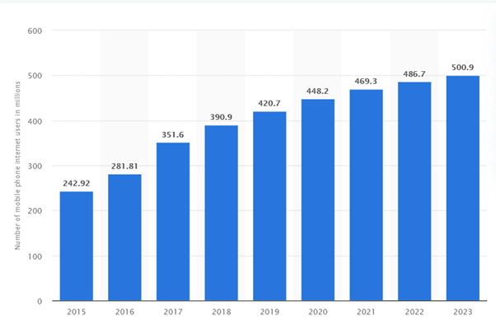
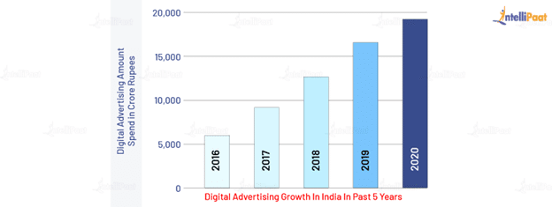
WHY DIGITAL MARKETING?
It is one of the most emerging ways of marketing.

Slide 5
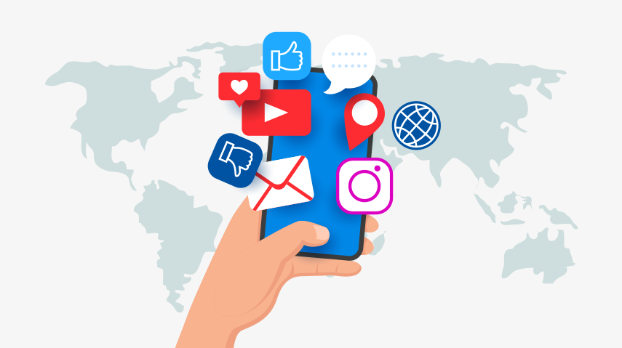
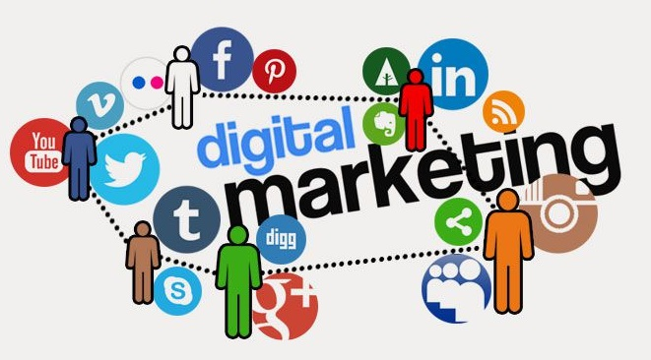
TYPES OF DIGITAL MARKETING:
Search Engine Optimization (SEO)
Paid Social and Paid Search Advertising
Email Marketing
Content Marketing
Affiliate Marketing
Mobile Marketing
Social Media Marketing

Slide 6
YES YOU CAN EARN!!
Make money as a Content Writer.
Earn money with Affiliate Marketing.
Work as a social media manager.
Become a Youtuber.
Create your own website.
Sell Ads and earn money.
Create and Sell your own digital products.
Become a Content Creator.

Slide 7


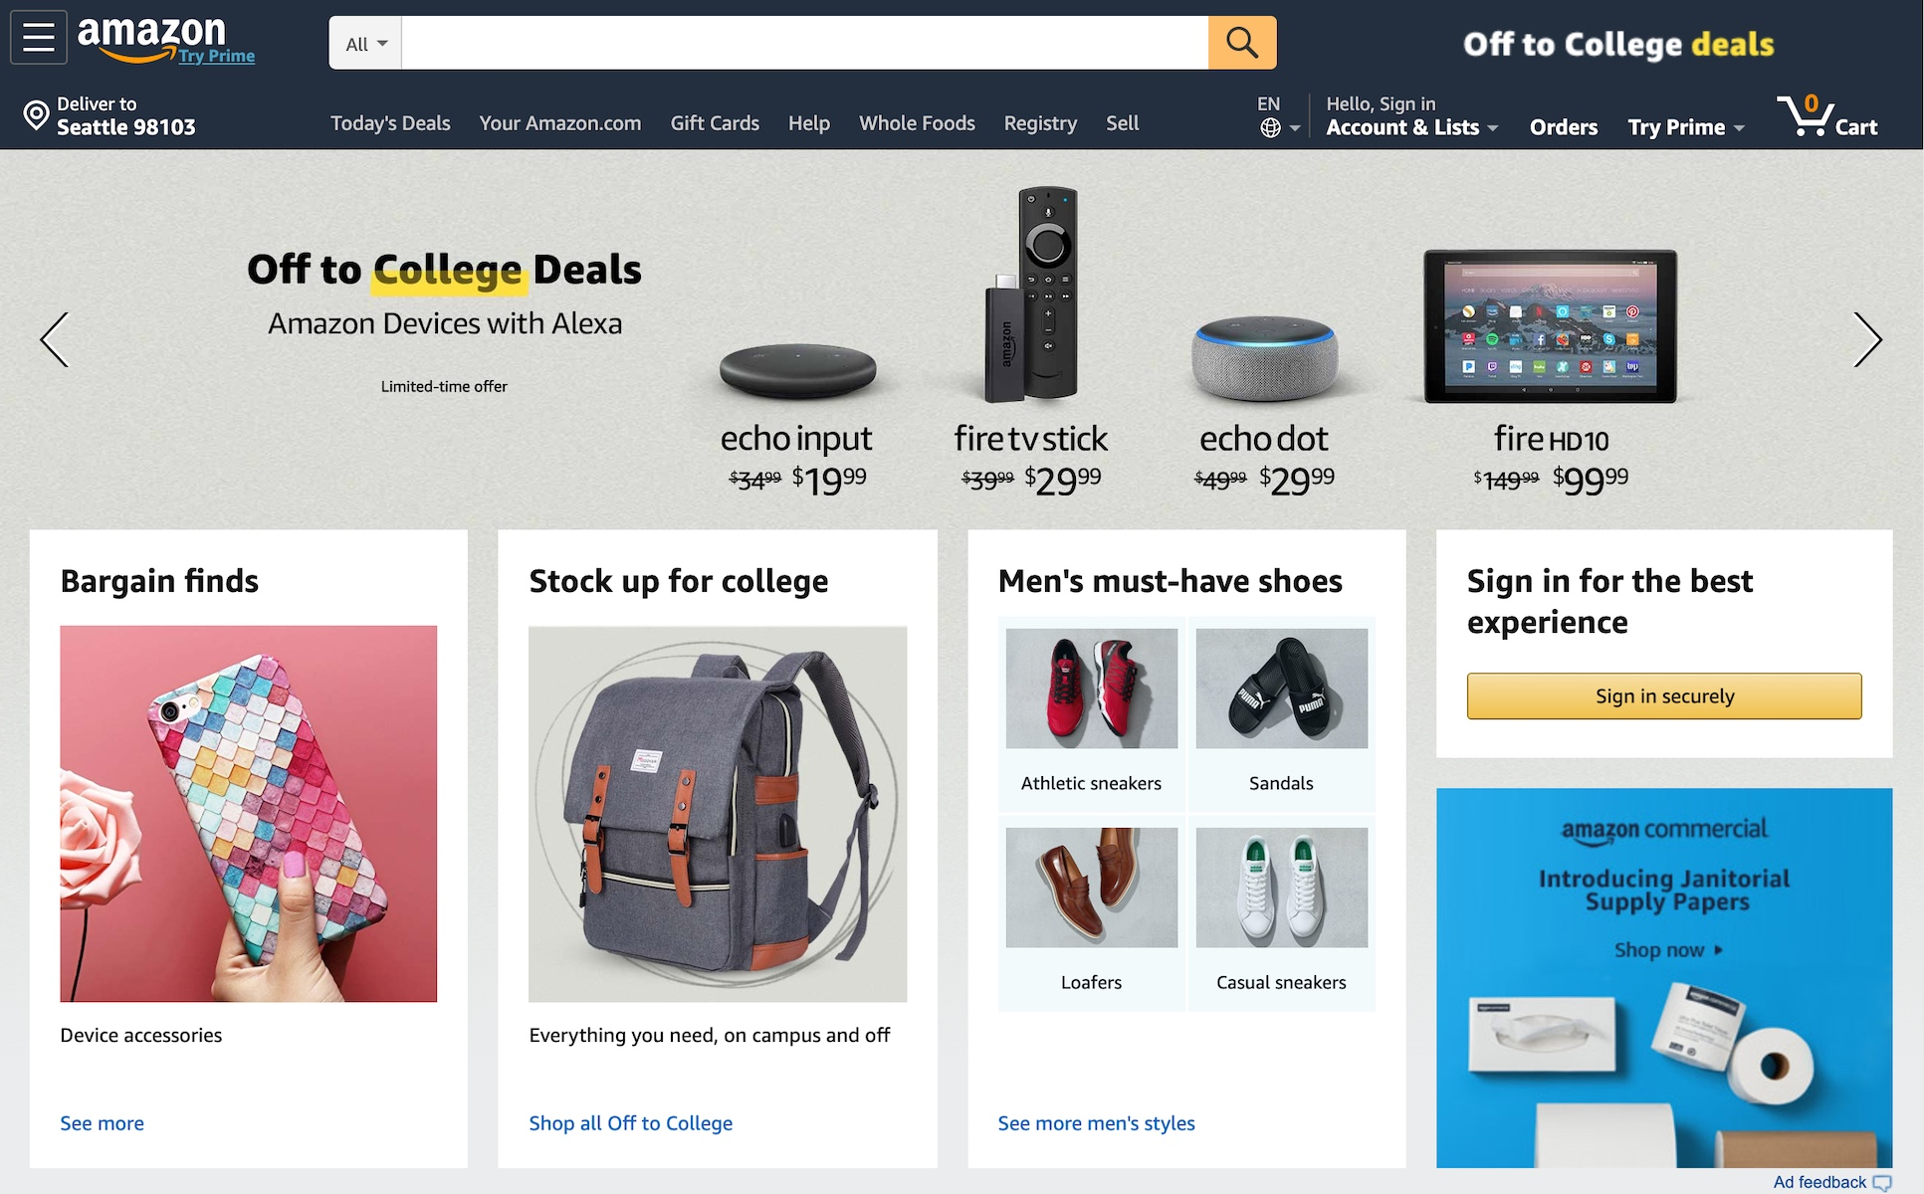
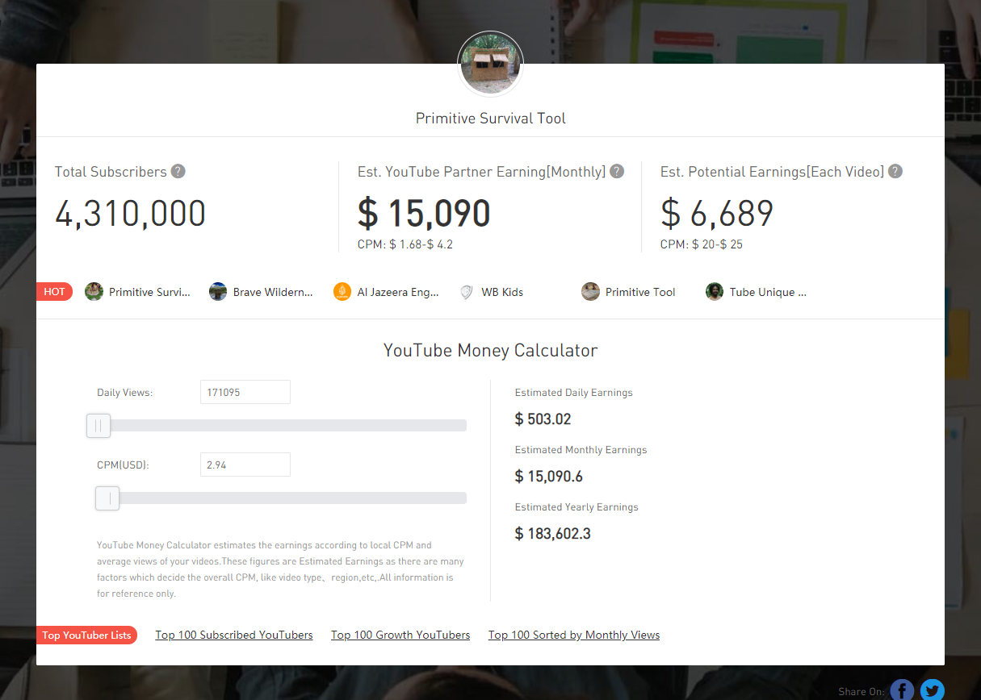
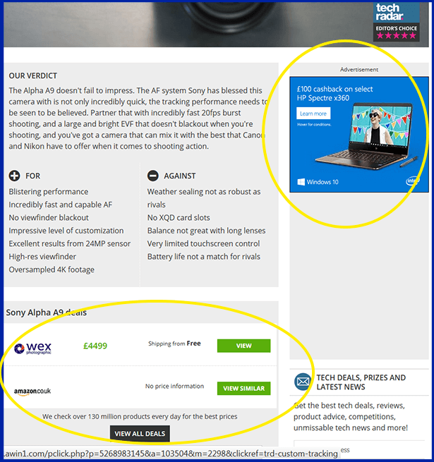

POPULAR EXAMPLES

Slide 8
THANK YOU!
By: Ruhisha Samnani

